Slide 1
INTELLIGENT AGENTS

Slide 2
Agent and Environment
Sensors
percepts
Environment
?
Agent
actions
Effectors

Slide 3
Agent and Environment
Anything that can be viewed as perceiving its environment through sensors and acting upon that environment through its effectors/actuators.
Example:
Human agent
Robotic agent
Software agent

Slide 4
Simple Terms -- [PAGE]
Percept
Agent’s perceptual inputs at any given instant
Percept sequence
Complete history of everything that the agent has ever perceived.
Action
An operation involving an actuator
Actions can be grouped into action sequences

Slide 5
A Windshield Wiper Agent
How do we design a agent that can wipe the windshields
when needed?
Goals?
Percepts?
Sensors?
Effectors?
Actions?
Environment?

Slide 6
A Windshield Wiper Agent (Cont’d)
Goals: Keep windshields clean & maintain visibility
Percepts: Raining, Dirty
Sensors: Camera (moist sensor)
Effectors: Wipers (left, right, back)
Actions: Off, Slow, Medium, Fast
Environment: Inner city, highways, weather

Slide 7
Interacting Agents
Collision Avoidance Agent (CAA)
Goals: Avoid running into obstacles
Percepts ?
Sensors?
Effectors ?
Actions ?
Environment: Freeway
Lane Keeping Agent (LKA)
Goals: Stay in current lane
Percepts ?
Sensors?
Effectors ?
Actions ?
Environment: Freeway

Slide 8
Interacting Agents
Collision Avoidance Agent (CAA)
Goals: Avoid running into obstacles
Percepts: Obstacle distance, velocity, trajectory
Sensors: Vision, proximity sensing
Effectors: Steering Wheel, Accelerator, Brakes, Horn, Headlights
Actions: Steer, speed up, brake, blow horn, signal (headlights)
Environment: Highway
Lane Keeping Agent (LKA)
Goals: Stay in current lane
Percepts: Lane center, lane boundaries
Sensors: Vision
Effectors: Steering Wheel, Accelerator, Brakes
Actions: Steer, speed up, brake
Environment: Highway

Slide 9
Agent function & program
Agent’s behavior is mathematically described by
Agent function
A function mapping any given percept sequence to an action
Practically it is described by
An agent program
The real implementation

Slide 10
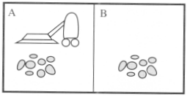
Vacuum-cleaner world
Perception: Clean or Dirty? where it is in?
Actions: Move left, Move right, suck, do nothing

Slide 11
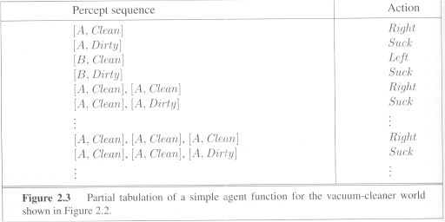
Vacuum-cleaner world

Slide 12
Program implements the agent function
Function Reflex-Vacuum-Agent([location,statuse]) return an action
If status = Dirty then return Suck
else if location = A then return Right
else if location = B then return left

Slide 13
Agents
Have sensors, actuators, goals
Agent program
Implements mapping from percept sequences to actions
Performance measure to evaluate agents
Autonomous agent decide autonomously which action to take in the current situation to maximize the progress towards its goals.

Slide 14
Behavior and performance of Agents in terms of agent function
Perception (sequence) to Action Mapping:
Ideal mapping: specifies which actions an agent ought to take at any point in time
Description: Look-Up-Table
Performance measure: a subjective measure to characterize how successful an agent is (e.g., speed, power usage, accuracy, money, etc.)
(degree of) Autonomy: to what extent is the agent able to make decisions and take actions on its own?

Slide 15
Performance measure
A general rule:
Design performance measures according to
What one actually wants in the environment
Rather than how one thinks the agent should behave
E.g., in vacuum-cleaner world
We want the floor clean, no matter how the agent behave
We don’t restrict how the agent behaves

Slide 16
Agents
Fundamental faculties of intelligence
Acting
Sensing
Understanding, reasoning and learning
In order to act you must sense.
Robotics: Sensing and acting, understanding is not necessary

Slide 17
Intelligent Agents
Must sense
Must act
Must be autonomous
Must be rational

Slide 18
Rational Agent
AI is about building rational agents
A rational agent always does the right thing.
What are the functionalities?
What are the components?
How do we build them?

Slide 19
How is an Agent different from other software?
Agents are autonomous, that is, they act on behalf of the user
Agents contain some level of intelligence, from fixed rules to learning engines that allow them to adapt to changes in the environment
Agents don't only act reactively, but sometimes also proactively

Slide 20
How is an Agent different from other software?
Agents have social ability, that is, they communicate with the user, the system, and other agents as required
Agents may also cooperate with other agents to carry out more complex tasks than they themselves can handle
Agents may migrate from one system to another to access remote resources or even to meet other agents

Slide 21
Rationality
What is rational at any given time depends on four things:
The performance measure defining the criterion of success
The agent’s prior knowledge of the environment
The actions that the agent can perform
The agents’s percept sequence up to now

Slide 22
Rational agent
For each possible percept sequence,
an rational agent should select
an action expected to maximize its performance measure, given the evidence provided by the percept sequence and whatever built-in knowledge the agent has
E.g., an exam
Maximize marks, based on
the questions on the paper & your knowledge

Slide 23
Example of a rational agent
Performance measure
Awards one point for each clean square
at each time step, over a lifetime of 10000 time steps
Prior knowledge about the environment
The geography of the environment
Only two squares
The effect of the actions

Slide 24
Example of a rational agent
Actions that can perform
Left, Right, Suck and No Op
Percept sequences
Where is the agent?
Whether the location contains dirt?
Under this circumstance, the agent is rational.

Slide 25
Omniscience
An omniscient agent
Knows the actual outcome of its actions in advance
No other possible outcomes
However, impossible in real world

Slide 26
Omniscience
Based on the circumstance, it is rational.
As rationality maximizes
Expected performance
Perfection maximizes
Actual performance
Hence rational agents are not omniscient.

Slide 27
Learning
Does a rational agent depend on only current percept?
No, the past percept sequence should also be used
This is called learning
After experiencing an episode, the agent
should adjust its behaviors to perform better for the same job next time.

Slide 28
Autonomy
If an agent just relies on the prior knowledge of its designer rather than its own percepts then the agent lacks autonomy
A rational agent should be autonomous- it should learn what it can to compensate for partial or incorrect prior knowledge.

Slide 29
Nature of Environments
Task environments are the problems
While the rational agents are the solutions
Specifying the task environment through PEAS
In designing an agent, the first step must always be to specify the task environment as fully as possible.
Eg: Automated taxi driver

Slide 30
Task environments
Performance measure
How can we judge the automated driver?
Which factors are considered?
getting to the correct destination
minimizing fuel consumption
minimizing the trip time and/or cost
minimizing the violations of traffic laws
maximizing the safety and comfort, etc.

Slide 31
Task environments
Environment
A taxi must deal with a variety of roads
Traffic lights, other vehicles, pedestrians, stray animals, road works, police cars, etc.
Interact with the customer

Slide 32
Task environments
Actuators (for outputs)
Control over the accelerator, steering, gear shifting and braking
A display to communicate with the customers
Sensors (for inputs)
Detect other vehicles, road situations
GPS (Global Positioning System)
Odometer, engine sensors……

Slide 33
Properties of task environments
Fully observable vs. Partially observable
If an agent’s sensors give it access to the complete state of the environment at each point in time then the environment is fully observable
An environment might be Partially observable because of noisy and inaccurate sensors or because parts of the state are simply missing from the sensor data.
Fully observable environments are convinient because the agent need not manitain any internal state to keep track of the world.

Slide 34
Properties of task environments
Single agent VS. multiagent
Playing a crossword puzzle – single agent
Chess playing – two agents
Competitive multiagent environment
Chess playing
Cooperative multiagent environment
Automated taxi driver
Avoiding collision

Slide 35
Properties of task environments
Deterministic vs. stochastic
next state of the environment Completely determined by the current state and the actions executed by the agent, then the environment is deterministic, otherwise, it is Stochastic.
Environment is uncertain if it is not fully observable or not deterministic
Outcomes are quantified in terms of probability
-taxi driver is Stochastic
- Vacuum cleaner may be deterministic or stochastic

Slide 36
Properties of task environments
Episodic vs. sequential
An episode = agent’s single pair of perception & action
The quality of the agent’s action does not depend on other episodes
Every episode is independent of each other
Episodic environment is simpler
The agent does not need to think ahead
Sequential
Current action may affect all future decisions
-Ex. Taxi driving and chess.

Slide 37
Properties of task environments
Static vs. dynamic
A dynamic environment is always changing over time
E.g., the number of people in the street
While static environment
E.g., the destination
Semidynamic
environment is not changed over time
but the agent’s performance score does
E.g., chess when played with a clock

Slide 38
Properties of task environments
Discrete vs. continuous
If there are a limited number of distinct states, clearly defined percepts and actions, the environment is discrete
E.g., Chess game, Taxi driving

Slide 39
Properties of task environments
Known vs. unknown
This distinction refers not to the environment itslef but to the agent’s (or designer’s) state of knowledge about the environment.
In known environment, the outcomes for all actions are given. ( example: solitaire card games).
If the environment is unknown, the agent will have to learn how it works in order to make good decisions.( example: new video game).

Slide 40
Properties of task environments
Fully observable vs. Partially observable
Single agent VS. multiagent
Deterministic vs. stochastic
Episodic vs. sequential
Static vs. dynamic
Discrete vs. continuous
Known vs. unknown

Slide 41
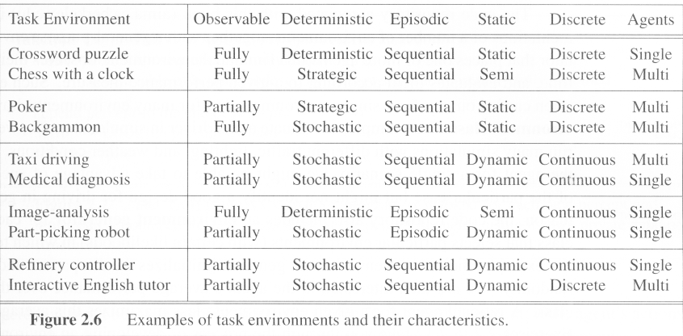
Examples of task environments

Slide 42
Structure of agents
Agent = architecture + program
Architecture = some sort of computing device (sensors + actuators)
(Agent) Program = some function that implements the agent mapping = “?”
Agent Program = Job of AI

Slide 43
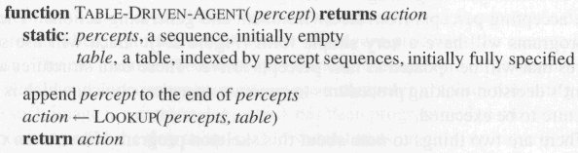
Agent programs
Skeleton design of an agent program

Slide 44
Types of agent programs
Table-driven agents
Simple reflex agents
Model-based reflex agents
Goal-based agents
Utility-based agents
Learning agents

Slide 45
(1) Table-driven agents
Table lookup of percept-action pairs mapping from every possible perceived state to the optimal action for that state
Problems
Too big to generate and to store (Chess has about 10¹²⁰ states, for example)
No knowledge of non-perceptual parts of the current state
Not adaptive to changes in the environment; requires entire table to be updated if changes occur
Looping: Can’t make actions conditional on previous actions/states

Slide 46
(1) Simple reflex agents
Rule-based reasoning to map from percepts to optimal action; each rule handles a collection of perceived states
Problems
Still usually too big to generate and to store
Still no knowledge of non-perceptual parts of state
Still not adaptive to changes in the environment; requires collection of rules to be updated if changes occur

Slide 47
A Simple Reflex Agent in Nature
percepts
(size, motion)
RULES:
(1) If small moving object,
then activate SNAP
(2) If large moving object,
then activate AVOID and inhibit SNAP
ELSE (not moving) then NOOP
Action: SNAP or AVOID or NOOP

Slide 48
Simple Vacuum Reflex Agent
function Vacuum-Agent([location,status])
returns Action
if status = Dirty then return Suck
else if location = A then return Right
else if location = B then return Left

Slide 49
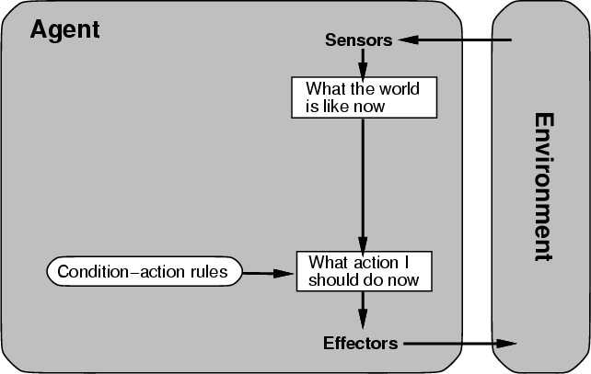
(1) Simple reflex agent architecture

Slide 50
(2) Model-based reflex agents
Encode “internal state” of the world to remember the past as contained in earlier percepts.
Requires two types of knowledge
How the world evolves independently of the agent?
How the agent’s actions affect the world?

Slide 51
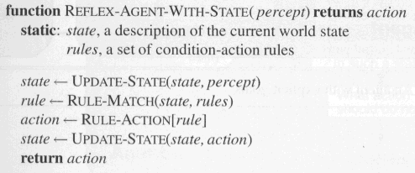
Model-based Reflex Agents
The agent is with memory

Slide 52
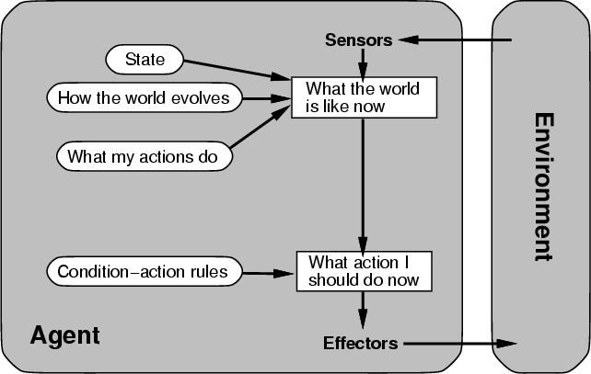
(2)Model-based agent architecture

Slide 53
(3) Goal-based agents
Choose actions so as to achieve a (given or computed) goal.
A goal is a description of a desirable situation.
Keeping track of the current state is often not enough − need to add goals to decide which situations are good
Deliberative instead of reactive.
May have to consider long sequences of possible actions before deciding if goal is achieved – involves consideration of the future, “what will happen if I do...?”

Slide 54
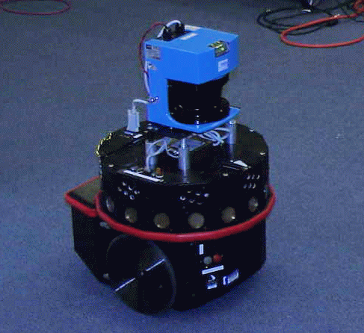
Example: Tracking a Target
The robot must keep the target in view
The target’s trajectory is not known in advance
The robot may not know all the obstacles in advance
Fast decision is required
robot
target

Slide 55
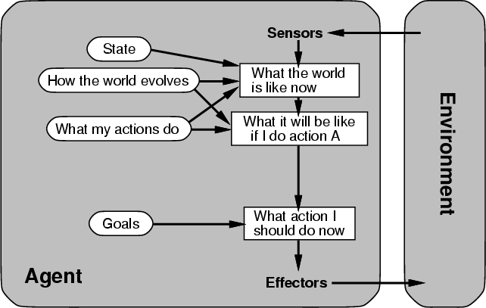
(3) Architecture for goal-based agent

Slide 56
(4) Utility-based agents
When there are multiple possible alternatives, how to decide which one is best?
A goal specifies a crude distinction between a happy and unhappy state, but often need a more general performance measure that describes “degree of happiness.”
Utility function U: State → Reals indicating a measure of success or happiness when at a given state.
Allows decisions comparing choice between conflicting goals, and choice between likelihood of success and importance of goal (if achievement is uncertain).

Slide 57
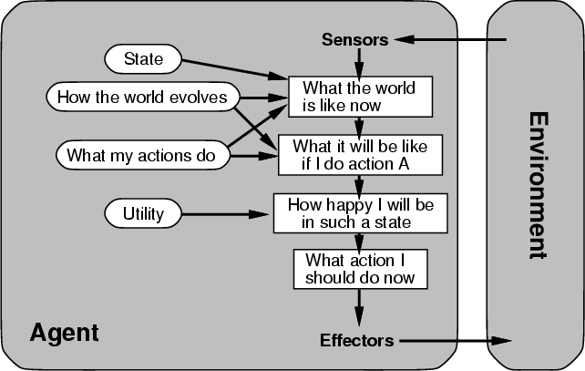
(4) Architecture for a complete utility-based agent

Slide 58
Learning Agents
After an agent is programmed, can it work immediately?
No, it still need teaching
In AI,
Once an agent is done
We teach it by giving it a set of examples
Test it by using another set of examples
We then say the agent learns
A learning agent

Slide 59
Learning Agents
Four conceptual components
Learning element
Making improvement
Performance element
Selecting external actions
Critic
Tells the Learning element how well the agent is doing with respect to fixed performance standard.
(Feedback from user or examples, good or not?)
Problem generator
Suggest actions that will lead to new and informative experiences.

Slide 60
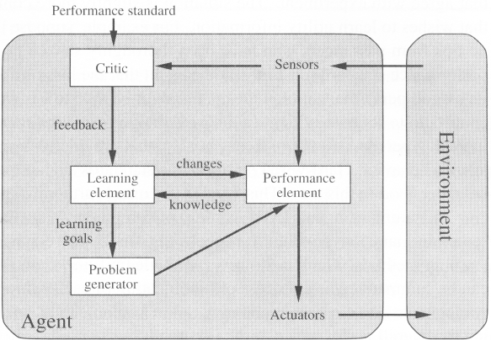
Learning Agents

Slide 61
Summary: Agents
An agent perceives and acts in an environment, has an architecture, and is implemented by an agent program.
Task environment – PEAS (Performance, Environment, Actuators, Sensors)
An ideal agent always chooses the action which maximizes its expected performance, given its percept sequence so far.
An autonomous learning agent uses its own experience rather than built-in knowledge of the environment by the designer.
An agent program maps from percept to action and updates internal state.
Reflex agents respond immediately to percepts.
Goal-based agents act in order to achieve their goal(s).
Utility-based agents maximize their own utility function.
Representing knowledge is important for successful agent design.
The most challenging environments are not fully observable, nondeterministic, dynamic, and continuous

